Slide 1




RESEARCH PRESENTATION
EnterpriseSynth: Agentic SFT + Eval Data from API Schemas Without Live Execution
OPENAPI SCHEMA
VERIFIED TRACE
OFFLINE
VERIFIED
Schema-aware agentic framework · Proof of concept and viability

Slide 2





The execution bottleneck
Traditional data generation assumes APIs can be called safely and repeatedly.
Sandbox limits
Privacy risk
Rate constraints
Enterprise APIs may be unavailable, costly, or impossible to execute in isolated environments.
Live traces can expose credentials, sensitive data, and operational behavior.
Infrastructure quotas and rate limits make large-scale trajectory collection brittle.
CORE QUESTION
Can the specification itself become the data source?

Slide 3



Useful agent behavior can be synthesized from structure—not execution.
INPUT
PROCESS
OUTPUT
OpenAPI specification
Schema-aware synthesis
Verified traces
Zero API keys · Zero calls · Deterministic schema checks

Slide 4

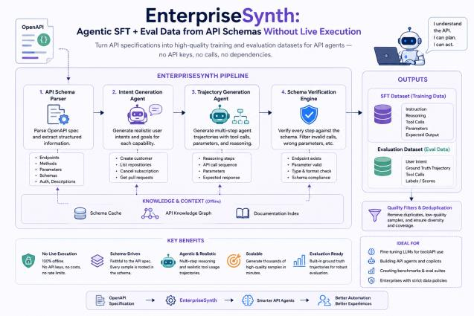
EnterpriseSynth at a glance
SYSTEM OVERVIEW
Four stages convert an API schema into SFT and evaluation datasets.

Slide 5


A four-stage synthesis pipeline
Each stage narrows the space of possible agent behavior.
01
02
03
04
API schema parsing
Intent synthesis
Trajectory generation
Schema verification
Extract endpoints, methods, parameters, schemas, and authentication descriptions.
Generate realistic user intents and goals for each API capability.
Create multi-turn tool-use traces with calls, parameters, and reasoning.
Reject invalid traces with deterministic structural checks.
SPECIFICATION → INTENT → TRAJECTORY → VERIFIED DATA

Slide 6




Verification by construction
Every generated step is checked against the source schema.
DETERMINISTIC CHECKS
Endpoint and method exist
Required parameters are present
Invalid traces never enter the dataset.
Types and formats match
Verification becomes a data-quality gate.
Trajectory structure is complete
No live API response is required for validation.
SAFE · REPEATABLE · AUDITABLE

Slide 7


Evaluation design
A compact downstream test of whether synthesized traces transfer.
HELD-OUT DOMAIN
MODEL
TRAINING SET
Zoom
Qwen2.5-0.5B
45
Compare the untuned base model with a model fine-tuned on EnterpriseSynth data.
LoRA fine-tuning measures whether a small model learns valid tool-use behavior.
examples
Three training epochs in the reported experiment.
Tool selection accuracy
Parameter validity
Training loss

Slide 8


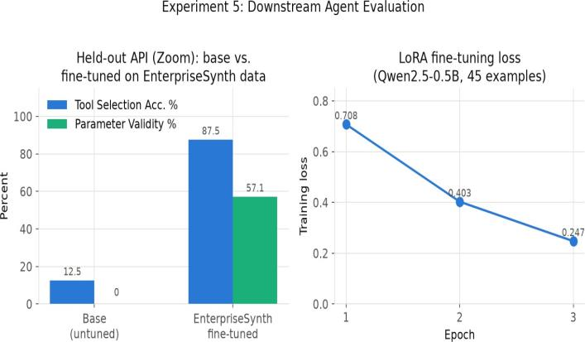


Downstream agent evaluation
12.5 → 87.5%
Tool selection accuracy
0 → 57.1%
Parameter validity
.708 → .247
Training loss, epoch 1→3
A small fine-tuning set produces a large improvement on a held-out API.

Slide 9




What the results establish
Evidence of viability
Current limits
SFT traces can be generated without live API calls.
45-example fine-tuning set
Schema checks provide a deterministic quality filter.
Single held-out API: Zoom
Fine-tuning improves held-out tool-use behavior.
Single reported model: Qwen2.5-0.5B
The experiment is a proof of concept—not yet a claim of broad generalization.

Slide 10
Thank you
EnterpriseSynth · Research presentation

